Slide 1
Multivector and SIMD Computers
Vector Processing Principles
Multivector Multiprocessors
Compound Vector Processing
SIMD Computer Organizations
The Connection Machine CM-5

Slide 2
Vector Processing Principles
A vector is a set of scalar data items, all of the same type, stored in memory. Usually, the vector elements are ordered to have a fixed addressing increment between successive elements called the stride.
A vector processor is an ensemble of hardware resources, including vector registers, functional pipelines, processing elements, and register counters, for performing vector operations. Vector processing occurs when arithmetic or logical operations are applied to vectors. The conversion from scalar processing to vector code is called vectorization.
Vector processing speedup 10..20 compared with scalar processing. A compiler capable of vectorization is called vectorizing compiler or vectorizer.

Slide 3
Vector instructions
1. Vector-vector instructions One or two vector operands are fetched form the respective vector registers, enter through a functional pipeline unit, and produce result in another vector register.
2. Vector-scalar instructions
3. vector-memory instructions Store-load of vector registers
4. Vector reduction instructions maximum, minimum, sum, mean value.
5. Gather and scatter instructions Two instruction registers are used to gather or scatter vector elements randomly through the memory (operations with sparse vectors).
6. Masking instructions The Mask vector is used to compress or to expand a vector to a shorter or longer index vector (bit per index correspondence).

Slide 4
Vector-access memory schemes
Vector operands may have arbitrary length.
Vector elements are not necessarily stored in contiguous memory locations.
To access a vector a memory, one must specify its base, stride, and length.
Since each vector register has fixed length, only a segment of the vector can be loaded into a vector register.
Vector operands should be stored in memory to allow pipelined and parallel access. Access itself should be pipelined.
C-Access memory organization The m-way low-order memory structure, allows m words to be accessed concurrently and overlapped.
S-Access memory organization All modules are accessed simultaneously storing consecutive words to data buffers. The low order address bits are used to multiplex the m words out of buffers.
C/S-Access memory organization.

Slide 5
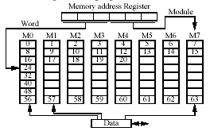
C-access
Eight-way interleaved memory (m = 8 and w = 8). m is called the degree of interleaving.
The major cycle is the total time required to complete the access of a single word form a memory. The minor cycle is the actual time needed to produce one word, assuming overlapped access of successive memory modules separated in every memory cycle .

Slide 6
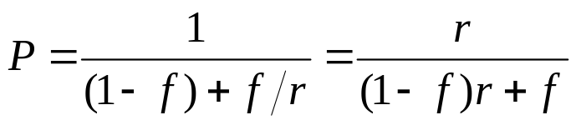
Relative Vector/Scalar Performance
Let r be the vector/scalar speed ratio and f the vectorization ratio.
By Ahmdahl's law the following relative performance can be defined:
The limiting case is P -> 1 if f -> 0.
Example: IBM - r = 3:::4, Cray - r = 10:::25.

Slide 7
Multivector Multiprocessors
Architecture Design Goals
Maintaining a good vector/scalar performance balance. The vector balance point is defined as the percentage of vector code in a program required to achieve equal utilization of vector and scalar hardware (usually 90...97%).
Supporting scalability with an increasing number of processors (The dominant problem involves support of shared memory with an increasing number of processor and memory ports).
Increasing memory system capacity (up to Tbytes today, hierarchy is necessary) and performance
Providing high-performance I/O (>50 Gbytes/s) and easy-access network.

Slide 8
Compound Vector Processing
A compound vector function (CVF) is defined as a composite function of vector operations converted from a looping structure of linked scalar operations.
Do 10 I=1,N
Load R1, X(I)
Load R2, Y(I)
Multiply R1, S
Add R2, R1
Store Y(I), R2
10 Continue
CVF: Y(1:N) = S X(1:N) + Y(1:N)
or
Y(I) = S X(I) + Y(I)

Slide 9
CVF Chaining and Strip-mining
Typical CVF for one-dimensional arrays are load, store, multiply, divide, logical and shifting operations.
*** The number of available vector registers and functional pipelines impose some restrictions on how many CVFs can be executed simultaneously.
Chaining
Chaining is an extension of technique of internal data forwarding practiced in scalar processors. Chaining is limited by the small number of functional pipelines available in a vector processor.
Strip-mining
When a vector has a length greater than that of the vector registers, segmentation of the long vector into fixed-length segments is necessary. One vector segment is processed at a time (in Cray computers segment is 64 elements).
Recurrence
The special case of vector loops in which the output of a functional pipeline may feed back into one of its own source vector registers.

Slide 10
SIMD Computer Organizations
SIMD models dierentiates on base of memory distribution and addressing scheme used. Most SIMD computers use a single control unit and distributed memories, except for a few that use associative memories.
Distributed memory model
Spatial parallelism among PEs. A distributed memory SIMD consists of an array of PEs (supplied with local memory) which are controlled by the array control unit. Program and data are loaded into the control memory through the host computer and distributed from there to PEs local memories.

Slide 11
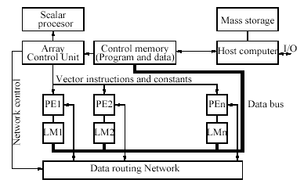
SIMD using distributed local memory

Slide 12
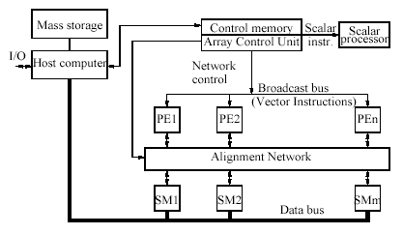
SIMD using shared-memory

